Slide 1

BUS7C3 International Organisational Branding
Lecture 9 - Understanding the Social Psychology of Brands

Slide 2

Learning Outcomes
By the end of this session, you will be able to
Understand the social psychology of brands
Evaluate brands and models of consumer behaviour.
Comprehend how factors influencing consumer involvement with products affect emotion.

Slide 3
Recap - What is a brand?
A brand is a label, designating ownership by a firm, which we experience, evaluate, have feeling towards, and build associations with to perceive value (Brakus et al., 2009).
Brands only exist in the minds of customers.
The power of a brand to influence perceptions can transform the experience of using the product.
Brands have a functional domain and an emotional/symbolic domain. See Fig. 1, next slide.

Slide 4
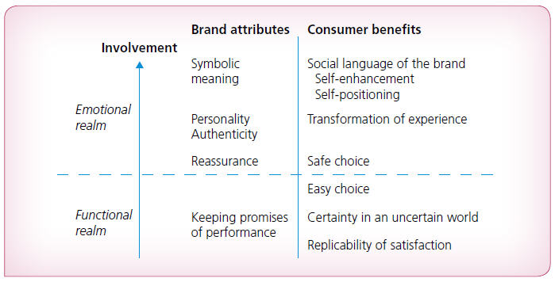
Figure 1: The Social Psychology of the Brand

Slide 5
Brands and models of consumer behaviour
The traditional models of consumer behaviour show consumers moving through a series of psychological states. See Fig 2 and Samsung, next 2 slides.
Do consumers always go through these stage and in this sequence?
Need/opportunity recognition
The motivation required to prompt a purchase may be at a much lower level than suggested
Information Search
Search is often limited

Slide 6
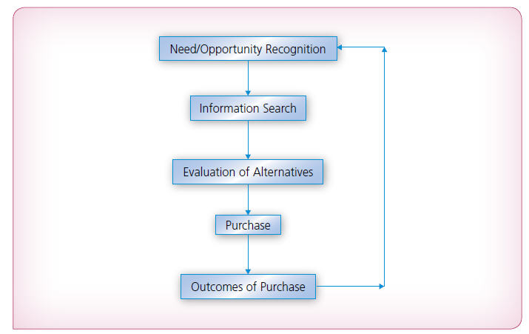
Figure 2: Classical model of consumer choice

Slide 7

Classical model of consumer choice Samsung

Slide 8
Brands and models of consumer behaviour
Evaluation of alternatives
Consumers look to reduce cognitive effort and use decision heuristics or ‘rules of thumb’
Purchase
Extent of planning
Choice of outlet
Retail brand
Outcomes of purchase
Expectancy Disconfirmation Model (Szymanski and Henard, 2001)
How much we learn from a purchase outcome will vary according to our motivation and cognitive bias
Some firms try to limit learning

Slide 9
Consumer involvement
Involvement is important to our understanding of consumer behaviour because it represents the personal relevance or importance that a product or brand has for an individual.
Involvement is a function of three sources of importance: the consumer, the product, and the situation.
Products are classified as high or low for ease of application although they really sit on a continuum and may vary between people and situations. See Fig 2, next slide.

Slide 10
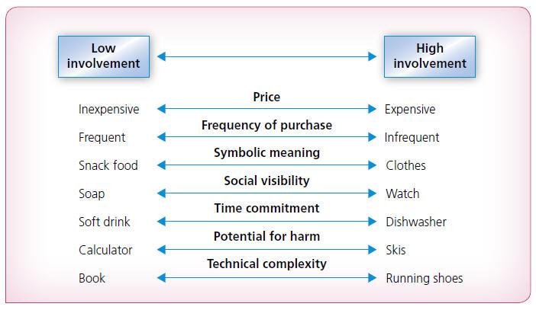
Figure 3: Factors influencing consumer involvement with products

Slide 11
Low-involvement choice
Brands are seen as very similar.
In most cases awareness of a brand is a key predictor of purchase, in that brands in ‘top-of-mind’ awareness are the only one's consumers are likely to choose from.
The major route to awareness is through past behaviour. See Fig 4 next slide.

Slide 12

Figure 4: Low-involvement choice

Slide 13
Low-involvement choice and emotion
Slightly positive emotional states lead to less thought, less information seeking, less analytic reasoning, less attention to negative cues, and less attention to ‘realism’.
Consumers are seeking a mild sense of warmth, rather than hot emotion, and seeking to choose the brand which they simply feel best about.
Mere exposure over time can result in non-rational preference
See Fig 5, next slide

Slide 14
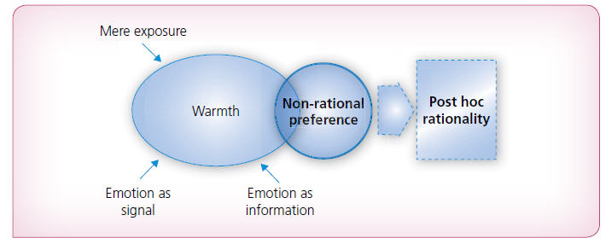
Figure 5: Low emotion choice

Slide 15
Brands and low-involvement choice
Choice between brands is driven largely by simple associations between the brand and attributes or emotions usually created and sustained through advertising.
Meaningful brands can be built from meaningless differentiation on irrelevant attributes (Carpenter et al., 1994).
Low-involvement processing is ‘the glue that holds the entire world of brands together’ (Heath, 2000).

Slide 16

Thank you!
Any questions?

